Slide 1

“Secure Coding AI”
Department of Computer Engineering
TERNA ENGINEERING COLLEGE
Nerul (W), Navi Mumbai 400706
Group ID : A10
Under the Guidance of :
Prof. Mohini misale Mam
Group Members: Harsh Jain A-58
Atharav Kadam A-54
Sayli Vekhande A-63
Arya Ratnakar A-47

Slide 2
Abstract
Software vulnerabilities remain one of the leading causes of security breaches in modern applications, with Injection Attacks consistently ranked among the most critical vulnerabilities in the OWASP Top 10. Although various platforms provide algorithmic coding practice, cybersecurity training, or vulnerability scanning tools, there is a limited focus on teaching developers how to write secure code during software development. This gap often results in developers learning how to detect or exploit vulnerabilities rather than preventing them through secure coding practices. To address this challenge, this project proposes SecureCode AI, a competitive secure coding education platform that enables learners to practice secure software development through hands-on vulnerability-based coding challenges. The initial version of the platform focuses exclusively on the Injection Attack category, covering its major subtypes through interactive programming exercises. Each submitted solution is evaluated for both functional correctness and security correctness, while learners receive educational feedback based on secure coding standards and best practices. The platform aims to strengthen developers' secure coding skills through practical learning rather than theoretical concepts alone. In future versions, the platform will be extended to include additional OWASP vulnerability categories, providing a comprehensive secure coding learning environment.

Slide 3
Introduction
With the rapid growth of web applications and digital services, developing secure software has become a critical requirement for modern software engineers. Despite advances in cybersecurity, software vulnerabilities continue to be one of the primary causes of data breaches and cyberattacks. Among these, Injection Attacks are consistently ranked among the most critical vulnerabilities in the OWASP Top 10 due to their high impact and widespread occurrence. Although numerous platforms provide vulnerability scanning, penetration testing, coding practice, or cybersecurity training, very few focus on teaching developers how to write secure code while building software. Existing educational platforms primarily emphasize algorithmic programming, offensive security, or vulnerability detection rather than secure coding practices. This creates a significant gap in secure software development education. To address this gap, our project proposes SecureCode AI, a competitive learning platform that enables users to practice secure coding through vulnerability-based programming challenges. In the initial version, the platform focuses specifically on the Injection Attack category and its major subtypes, allowing learners to identify, fix, and prevent injection vulnerabilities through hands-on coding exercises. The platform evaluates both the functional correctness and security correctness of submitted solutions while providing educational feedback to improve secure coding skills. Future versions will extend the platform to cover additional OWASP vulnerability categories.

Slide 4
Literature Survey
Sr No. | Paper (Authors) | Key Findings | Vulnerabilities Addressed | Limitations
1 | Secure Coding with AI – From Detection to Repair (Vladislav Belozerov, Peter J. Barclay, Ashkan Sami, 2026) | Evaluated GPT-4.1, GPT-5 and Claude for real-world vulnerability detection and repair. Modern LLMs repaired around 75–80% of detected vulnerabilities. | SQL Injection, Command Injection, Buffer Overflow, Path Traversal, Hardcoded Secrets, Integer Overflow, Memory Corruption, Input Validation flaws | Focuses only on evaluating LLMs for vulnerability detection and repair. Does not provide an interactive secure coding practice platform, coding challenges, learner progress tracking, or AI-assisted educational feedback.
2 | An Empirical Study on LLM-Driven Secure Code Generation (Hao Yan, Swapneel S. Vaidya, Xiaokuan Zhang, Ziyu Yao, 2025) | Demonstrated that self-generated vulnerability hints significantly improve secure code generation and vulnerability repair by LLMs. | SQL Injection, Command Injection, Buffer Overflow, Path Traversal, Hardcoded Credentials, Weak Input Validation | Focuses on improving LLM code generation rather than building a learning platform. Does not support secure coding exercises, user assessment, or personalized developer learning.
3 | Design of Secure Coding Challenges for Cybersecurity Education in the Industry (Tiago Gasiba, Ulrike Lechner, Maria Pinto-Albuquerque, Alae Zouitni, 2021) | Introduces Capture-the-Flag (CTF) challenge structures to improve developers' secure coding skills. | SQL Injection, XSS, Buffer Overflow, Authentication flaws, Secure Coding Practices | Provides challenge design only. Does not include automated code evaluation, AI-generated explanations, adaptive learning, or progress tracking.

Slide 5
Sr No. | Paper (Authors) | Key Findings | Vulnerabilities Addressed | Limitations
4 | The Role of Generative AI in Strengthening Secure Software Coding Practices (Hathal S. Alwageed, Rafiq Ahmad Khan, 2025) | Reviews how GenAI improves secure coding, vulnerability detection and developer productivity. | SQL Injection, Cross-Site Scripting (XSS), Buffer Overflow, Input Validation issues | Provides theoretical discussion only. No implementation of a secure coding platform, coding challenges, AI feedback, or vulnerability assessment workflow.
5 | Secure Coding with AI Coding Assistants: From Preventive to Reactive Security (Faisal Haque Bappy et al., 2026) | Shows AI coding assistants shift developers from writing secure code proactively to reviewing security after code generation. | General secure coding awareness for OWASP Top 10 vulnerabilities | Focuses on developer behaviour rather than developing a secure coding education platform with automated vulnerability detection, scoring, and learning analytics.
6 | Is Secure Coding Education in the Industry Needed? (Tiago Espinha Gasiba, Ulrike Lechner, Maria Pinto-Albuquerque, Daniel Mendez, 2021) | Large-scale survey reveals many developers lack awareness and compliance with secure coding guidelines. | General secure coding issues including SQL Injection, XSS, Authentication, Secure Coding Standards | Identifies the need for secure coding education but does not propose or implement an AI-assisted secure coding learning platform.
7 | SoK: AI Secure Code Generation – Progress, Pitfalls and Paths Forward (Rupam Patir, Keyan Guo, Haipeng Cai, Hongxin Hu, 2026) | Comprehensive survey introducing KAUGE framework for evaluating secure code generation using secure coding principles. | SQL Injection, Command Injection, Path Traversal, Weak Cryptography, Security Misconfiguration, Dependency Vulnerabilities | Survey paper only. Does not implement an AI-powered secure coding environment, automated code evaluation, or practical learning modules.

Slide 6
Sr No. | Paper (Authors) | Key Findings | Vulnerabilities Addressed | Limitations
8 | Using Real-World Bug Bounty Programs in Secure Coding Course (Kamil Malinka et al., 2024) | Demonstrates that integrating bug bounty programs into education improves practical vulnerability discovery skills. | Real-world Web Vulnerabilities (SQLi, XSS, Access Control, Misconfigurations depending on targets) | Depends on external bug bounty programs. Does not offer a structured AI-based learning environment with predefined secure coding exercises and automated assessment.
9 | A Systematic Mapping Study on Teaching Security Concepts in Programming Courses (Alina Torbunova, Adnan Ashraf, Ivan Porres, 2024) | Reviews approaches for teaching secure programming and identifies gaps in university-level cybersecurity education. | General Secure Coding Concepts, Common Vulnerabilities, Secure Programming Practices | Reviews existing teaching methods but does not propose an intelligent adaptive learning platform with AI-assisted vulnerability analysis and coding practice.
10 | Secure Coding Education Through Gamification and CTF Challenges (Tiago Gasiba et al., 2021) | Shows gamified secure coding exercises improve developer engagement and secure programming awareness. | SQL Injection, XSS, Buffer Overflow, Secure Authentication | Uses gamification but lacks AI-powered code analysis, automated vulnerability detection, personalized feedback, and secure coding performance analytics.

Slide 7
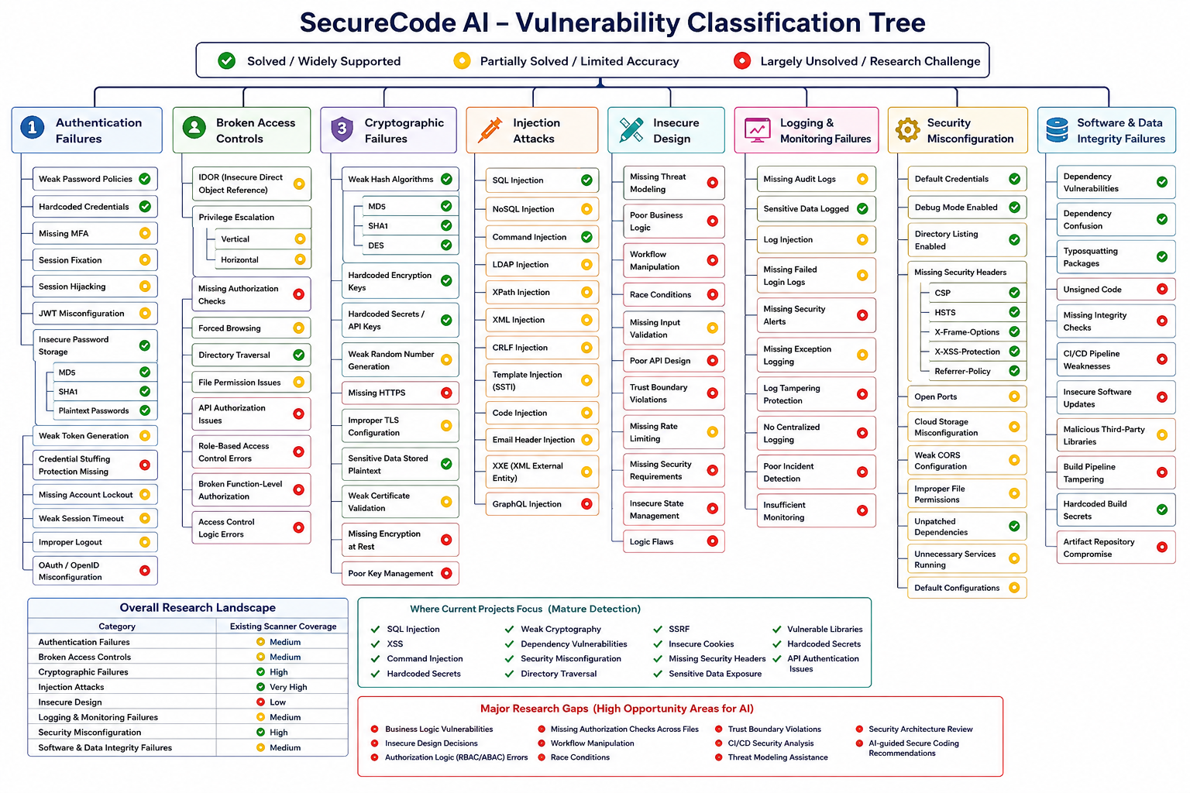

Slide 8
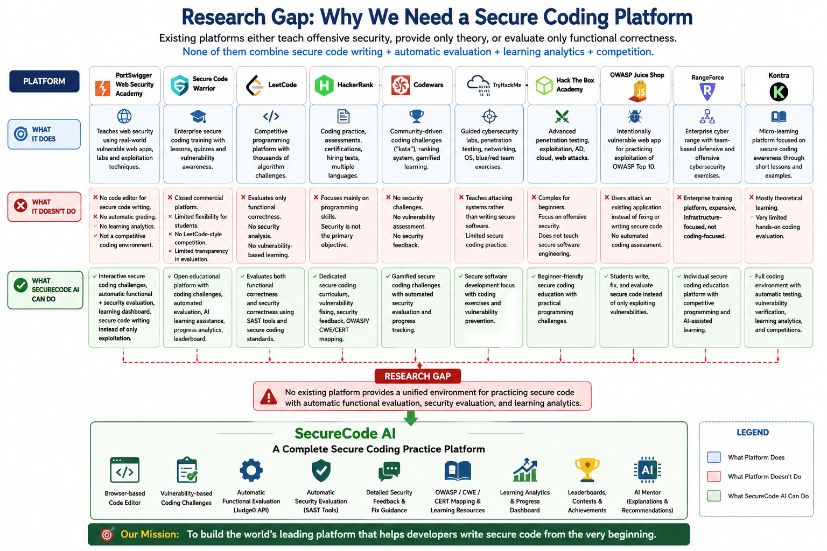

Slide 9
Research Gap
Most studies focus on AI-based vulnerability detection and repair, but do not provide an interactive platform for practicing secure coding.
Existing research emphasizes secure code generation using LLMs rather than developing developers' secure coding skills through hands-on programming exercises.
Survey papers discuss secure coding techniques and frameworks but lack practical implementation of an intelligent secure coding learning environment.
Current approaches provide theoretical discussions or developer assistance but do not integrate automated functional evaluation and security evaluation within a single platform.
Existing secure coding education methods and CTF-based challenges do not offer AI-assisted explanations, adaptive learning, personalized feedback, or learner progress tracking.
Bug bounty and cybersecurity training platforms depend on external environments and do not provide structured, curriculum-based secure coding exercises.
Most secure coding education research lacks a competitive programming environment where users can practice, evaluate, and improve secure coding skills through vulnerability-based coding challenges.
Therefore, there is a need for a unified platform that combines secure coding practice, automated code evaluation, AI-assisted educational feedback, learning analytics, and challenge-based learning to improve secure software development skills.

Slide 10
Problem Statement
Modern software applications are increasingly vulnerable to security flaws due to the lack of practical secure coding skills among developers. Existing educational platforms primarily focus on algorithmic programming, cybersecurity awareness, penetration testing, or vulnerability detection, but they provide limited opportunities to practice secure software development through real coding exercises. As a result, many developers are able to write functionally correct programs but struggle to implement secure coding practices that prevent vulnerabilities during development. There is a need for an interactive learning platform that enables developers to practice secure coding through vulnerability-based programming challenges, evaluate both functional and security correctness, and receive educational feedback to improve their secure software development skills.

Slide 11
Objectives
To develop an interactive platform for learning and practicing secure software development.
To improve developers' secure coding skills through vulnerability-based programming challenges.
To evaluate submitted code for both functional correctness and security correctness while providing AI-assisted educational feedback to help users understand, identify, and fix security vulnerabilities.
To promote hands-on secure coding practice through challenge-based learning while tracking user progress, strengths, and areas for improvement in secure software development.
To build a scalable platform that can support multiple vulnerability categories and programming languages in future versions.

Slide 12
Scope
The proposed platform focuses on secure coding education through practical programming challenges.
The initial implementation covers the Injection Attack category and its major subtypes as a proof of concept.
Users will solve coding challenges designed to identify, prevent, and fix security vulnerabilities.
The platform will automatically evaluate both functional correctness and security correctness of submitted solutions.
Secure coding guidance will be provided using recognized standards such as OWASP, CWE, and CERT.
The platform is intended for students, software developers, and secure coding learners.
Future versions will extend support to additional OWASP vulnerability categories, more programming languages, AI-assisted learning, and advanced exploit validation.
The system is designed to be modular and scalable, enabling continuous expansion with new challenges, security rules, and learning resources.

Slide 13
SRS
Functional Requirements
User Registration and Secure Login.
Browse vulnerability-based coding challenges.
Online code editor with multi-language support.
Code submission and functional correctness evaluation.
Security analysis of submitted code using static analysis tools.
Detailed feedback with secure coding recommendations.
Progress tracking and performance dashboard.
Admin module for managing users, challenges, and learning content.

Slide 14
Non-Functional Requirements
User-friendly and responsive interface.
Fast code compilation and evaluation.
Secure authentication and data protection.
Scalable architecture for adding new vulnerability categories.
High availability and reliable performance.
Maintainable and modular system architecture.
Cross-platform accessibility through modern web browsers.
Easy integration with external APIs and security analysis tools.

Slide 15
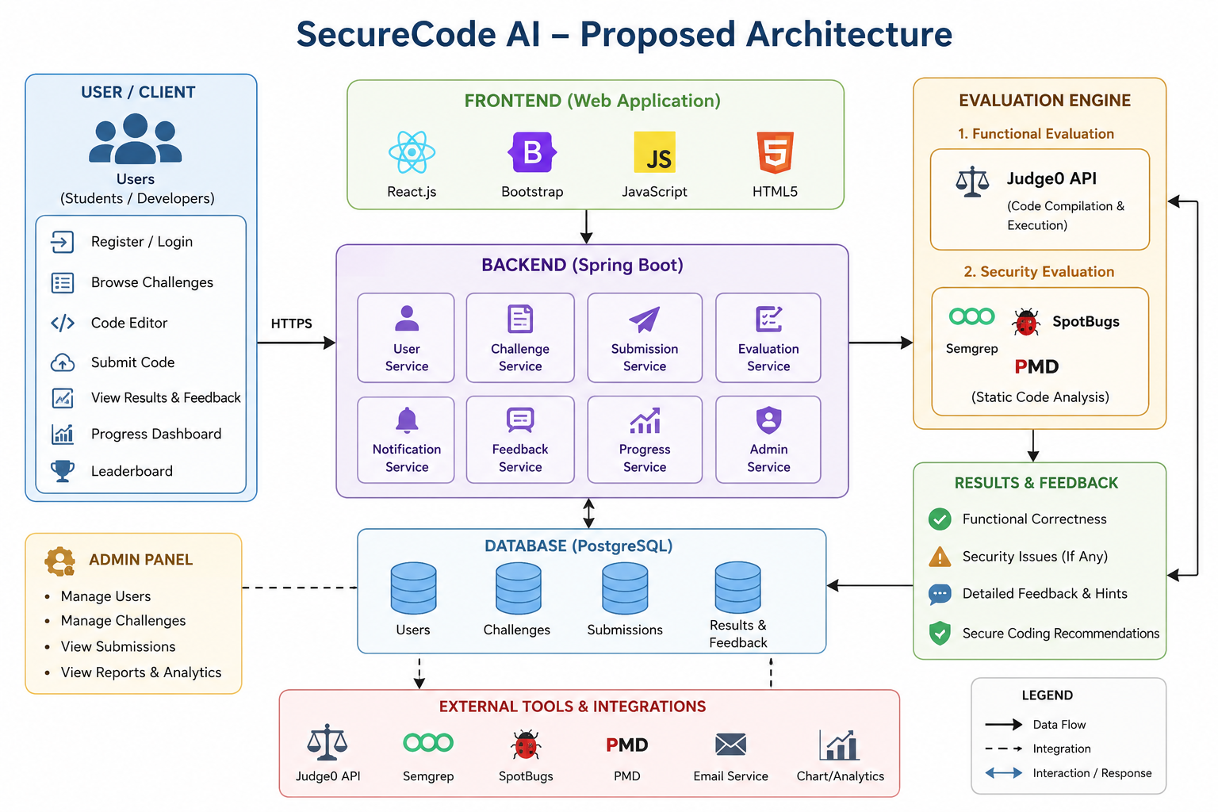

Slide 16
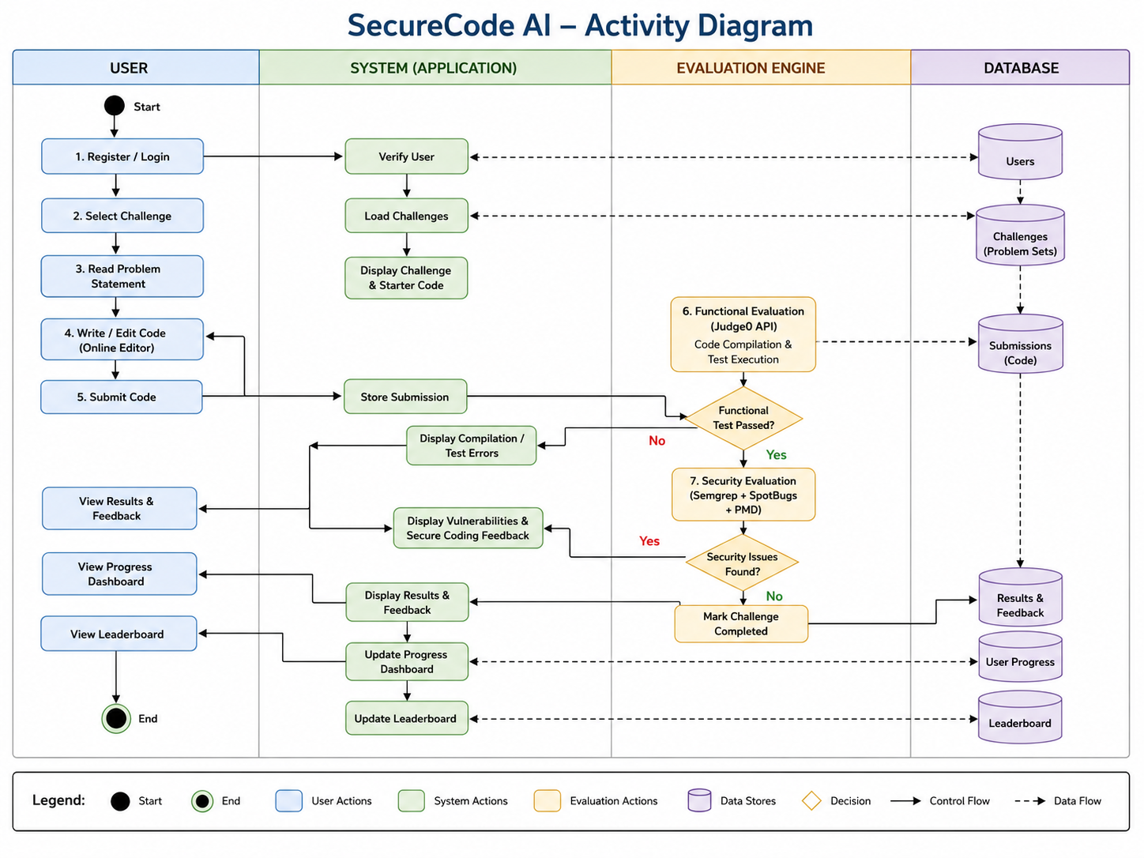

Slide 17
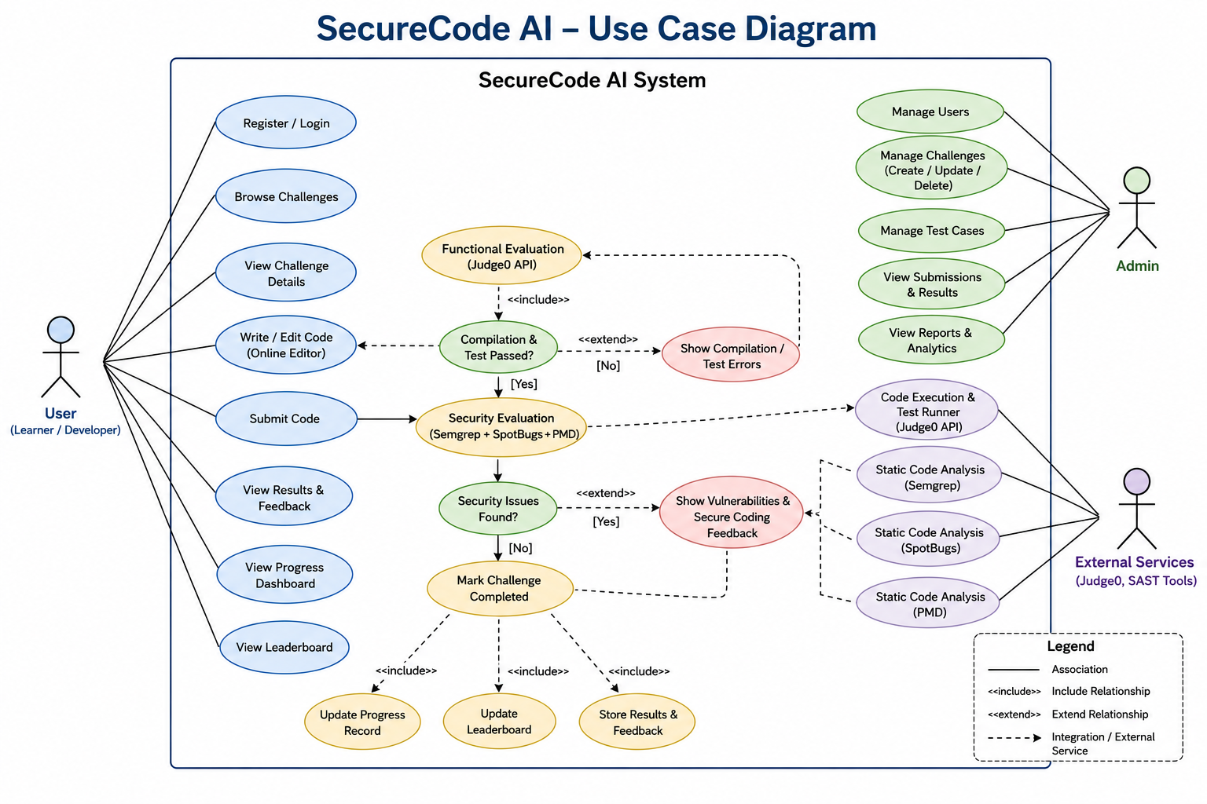

Slide 18
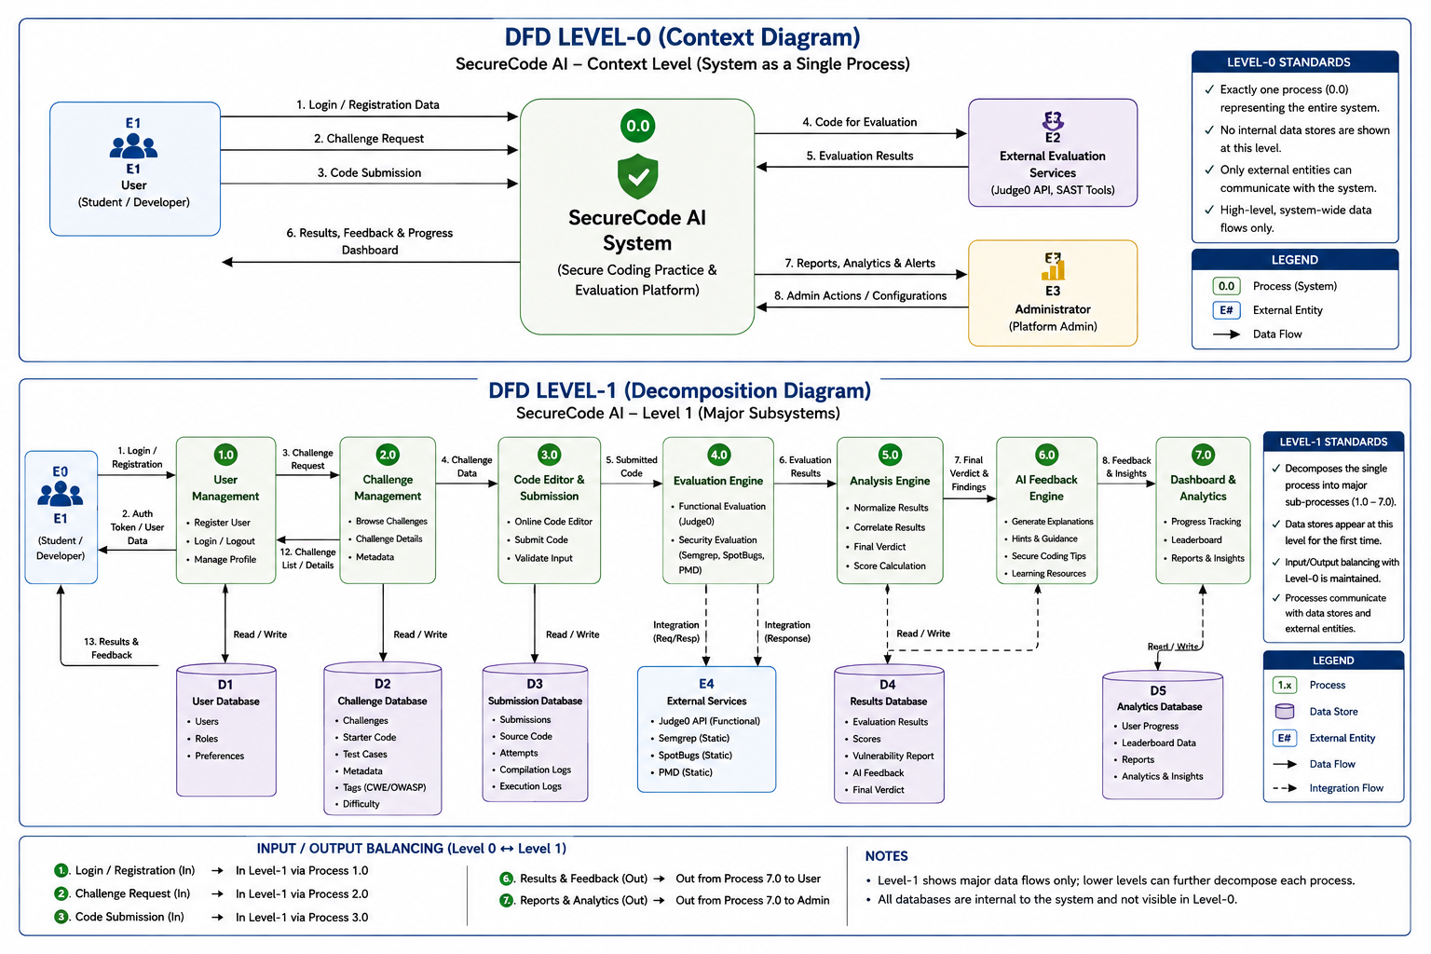

Slide 19
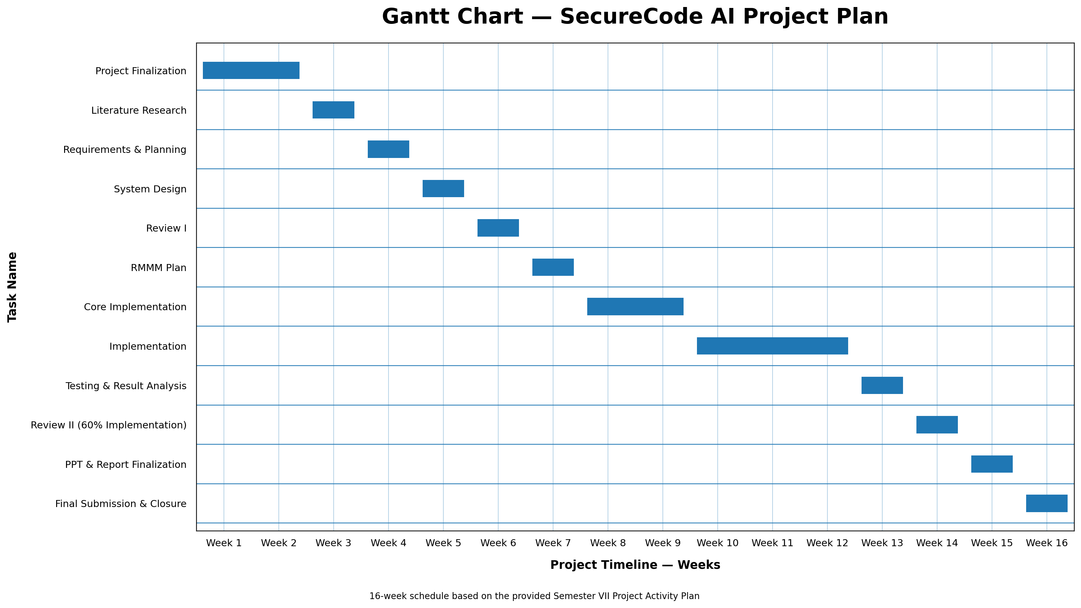

Slide 20
Conclusion
Software vulnerabilities continue to pose significant risks to modern software applications.
Existing platforms mainly focus on algorithmic programming, cybersecurity training, or vulnerability detection rather than secure coding practice.
The literature survey identifies a clear research gap in providing hands-on secure coding education during software development.
SecureCode AI aims to bridge this gap through vulnerability-based programming challenges and automated code evaluation.
The first phase of the project focuses on the Injection Attack category as a proof of concept for secure coding education.
The platform evaluates both functional correctness and security correctness while providing educational feedback to learners.
The proposed approach promotes practical secure coding skills and supports continuous learning through progress tracking and challenge-based education.
Future versions will expand the platform to include additional OWASP vulnerability categories, AI-assisted learning, and advanced security evaluation techniques.

Slide 21
References
[1] V. Belozerov, P. J. Barclay, A. Sami, et al., "Secure Coding with AI – From Detection to Repair," 2026.
[2] H. Yan, S. S. Vaidya, X. Zhang, and Z. Yao, "Guiding AI to Fix Its Own Flaws: An Empirical Study on LLM-Driven Secure Code Generation," 2025.
[3] R. Patir, K. Guo, H. Cai, and H. Hu, "SoK: AI Secure Code Generation – Progress, Pitfalls and Paths Forward," 2026.
[4] H. S. Alwageed and R. A. Khan, "The Role of Generative AI in Strengthening Secure Software Coding Practices," 2025.
[5] F. H. Bappy, et al., "Secure Coding with AI Coding Assistants: From Preventive to Reactive Security," 2026.
[6] T. E. Gasiba, U. Lechner, M. Pinto-Albuquerque, and D. Mendez, "Is Secure Coding Education in the Industry Needed?," 2021.
[7] T. Gasiba, U. Lechner, M. Pinto-Albuquerque, and A. Zouitni, "Design of Secure Coding Challenges for Cybersecurity Education in the Industry," 2021.
[8] K. Malinka, et al., "Using Real-World Bug Bounty Programs in Secure Coding Course," 2024.
[9] A. Torbunova, A. Ashraf, and I. Porres, "A Systematic Mapping Study on Teaching Security Concepts in Programming Courses," 2024.
[10] T. Gasiba, et al., "Secure Coding Education Through Gamification and CTF Challenges," 2021.

